Slide 1
HACK AND TACKLE-2020
Problem statement for Hackathon 1, Hardware & Software:
A bin that consists of materials which is to be weighed on regular basis, and the measured value must be sent to a remote operator for processing.
It should also have level indicators for the processing.
Indication should be from the bin once reaches the maximum threshold values in both 1&2 cases.
The bin should have tracking facility.
SOLUTION:
We are going to insert one ultrasonic sensor and one nodemcu, the ultrasonic sensor indicates the level of the bin’s capacity and the nodemcu will directly sends the message to the remote operator (respective in charger of the streets) along with location without using GPS as the GPS is already inbuilt in nodemcu. And this module is a detachable device which is easy to fix.
As soon as the message received to the remote operator ,he will come to the respective bin and scans the QR CODE or RF card to send the message using app, to the municipal office and they sends request to the cercle team who is available nearby the bin.
If the person who is nearby the bin , rejects or he is unavailable to reach the respective location, It automatically sends the request to another person in the cercle team.

Slide 2
HACK AND TACKLE-2020
Problem statement for Hackathon 1, Hardware & Software:
A bin that consists of materials which is to be weighed on regular basis and the measured value must be sent to a remote operator for processing.
It should also have level indicators for the processing.
Indication should be from the bin once reaches the maximum threshold values in both 1&2 cases.
The bin should have tracking facility.
SOLUTION:
We use a sensor which will automatically weighing the bin periodically and sends the weight to the controller attached.
We also use another sensor for indicating the level of the bin’s capacity more often and sends the level to the controller attached.
In receipt of the data from the sensors, the controller will immediately updates the sensor data’s to the cloud.
The remote operator in the municipal office (respective in charger of the bins) will be notified periodically about the bin’s status, along with the location information of the bin, without using GPS .
And this module is a detachable device which is easy to fix.
If the person who is nearer to the bin rejects this information or if he is unavailable to reach the respective location, It automatically sends the request to the next higher officials to respond the request.

Slide 3

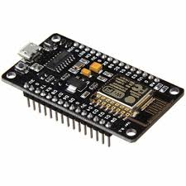
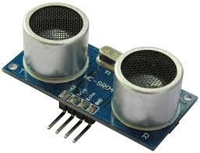

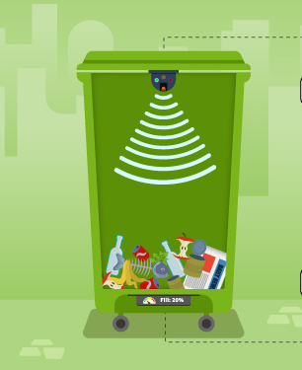






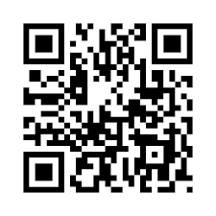
HARDWARE SIDE
SOFTWARE SIDE
DETACHABLE DEVICE
PERSON IN CERCLE TEAM
NODEMCU
ULTRASONIC
MUNICIPAL OFFICE
APP THAT SCANS QR CODE
REMOTE OPERATOR
SCANS QR CODE

